Slide 1
Hard Hats Detection in Unmanned Factory 無人廠房安全帽檢查
@Peter Chang
https://github.com/wildman8606/ARC_EM9D_AIoT_DK/

Slide 2
Outline
I. Introduction
II. Implement
III. Suggestion

Slide 3
Introduction

Slide 4
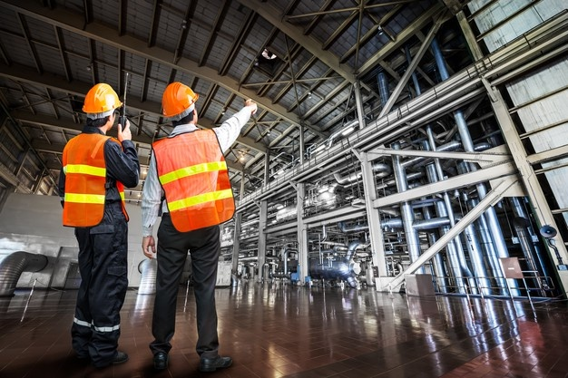
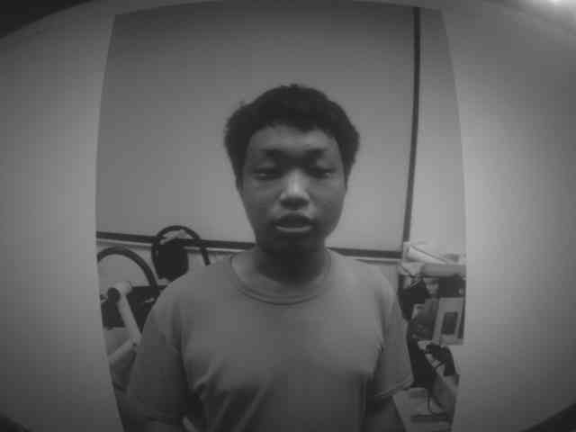
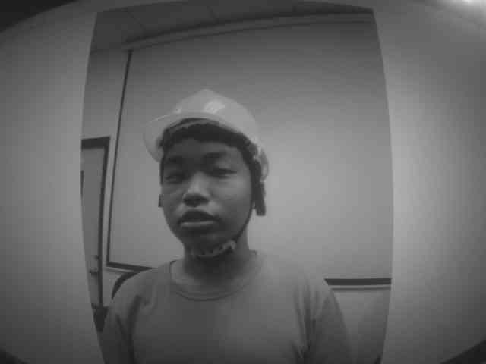


I. Introduction I-1. Abstract
The failure of factory personnel to wear safety equipment as required is one of the main causes of serious injuries. In order to avoid tragedies, this research uses human detection and object recognition technology to determine whether workers are wearing safety helmet as required when entering the construction site, so as to achieve automated safety inspections.
Define the detection Region of Interest (ROI) in the aisle image. When the worker enters the area of interest, the system starts to detect the person on the screen and obtain the image for detection. The detection result uses a light signal to show whether it meets the standard.
Fig. 1. Must wear a safety helmet
when entering the factory.
Fig. 2. The detection of whether
wearing safety helmets

Slide 5
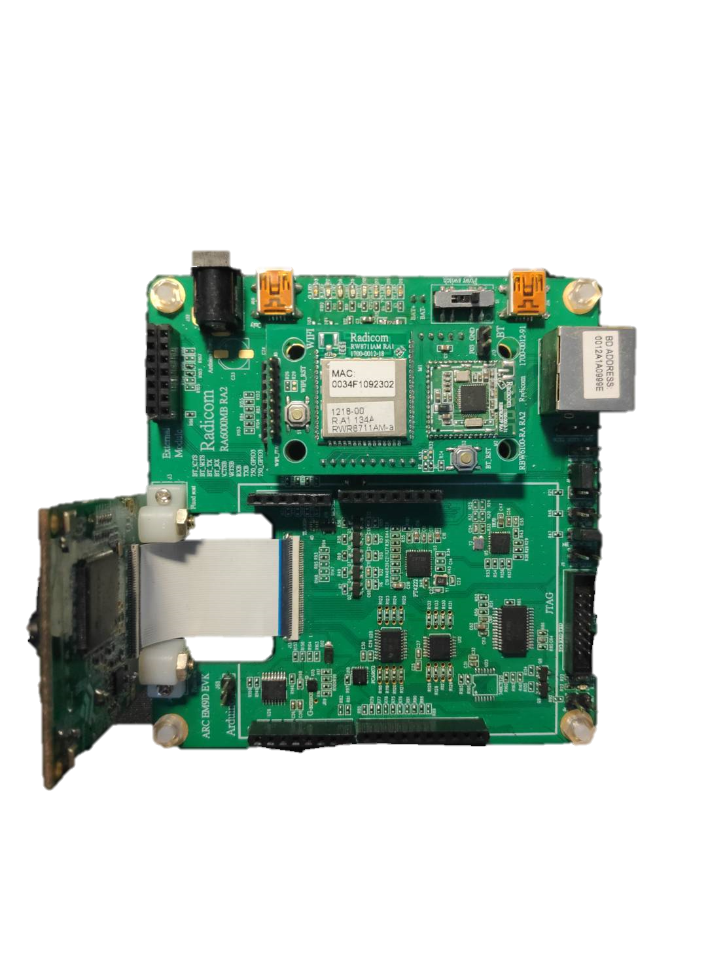


I. Introduction I-2. Situational Simulation
Situational Example.
PASS
Alert
Fig.3. Detecting safety helmet simulation

Slide 6
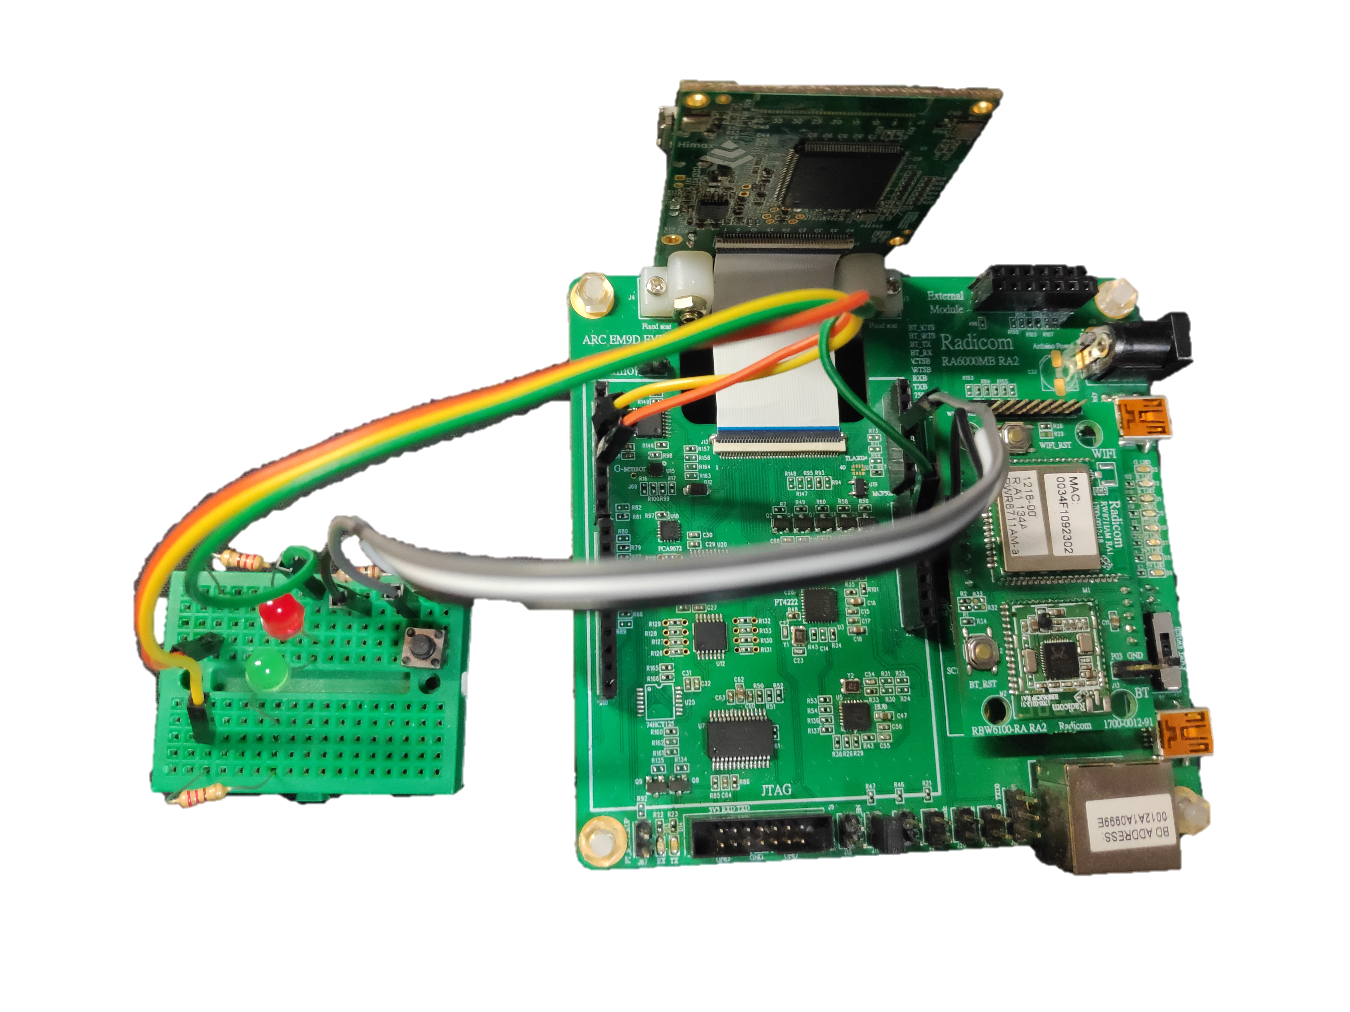
I. Introduction I-3. ARC EM9D AIoT DK
Button
Signal LEDs
EM9D
Fig. 4 Hard Hats Detection in Unmanned Factory

Slide 7
I. Introduction I-4. Flow Chart –user flow
Photoelectric Switch Check Region of Interest
Human Passing?
T
Camera Get Image
Model
Inference
Safety Helmet?
Correct signal
T
F
F
Warning
signal
Fig. 5 user case flow.

Slide 8
II. Implement II-1. Get Training Dataset
Step1: Download [Synopsys_SDK_V21] file
Step2: Enter folder [Lab3_Camera_v0] and make
$ cd \Synopsys_SDK_V21\Source_Project\Lab3_Camera_v0
$ make clean
$ make
$ make flash
Step3: In [Synopsys_SDK_V21\tools\image_gen_cstm\output]
folder find [output.img] file and copy

Slide 9
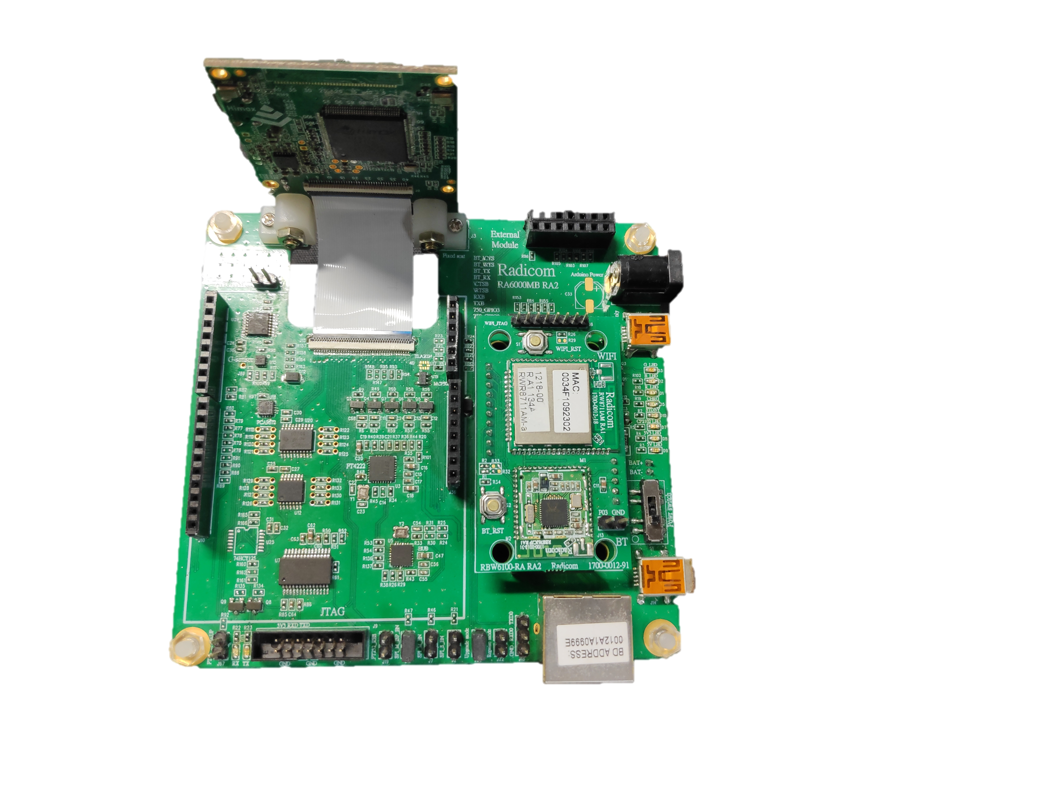
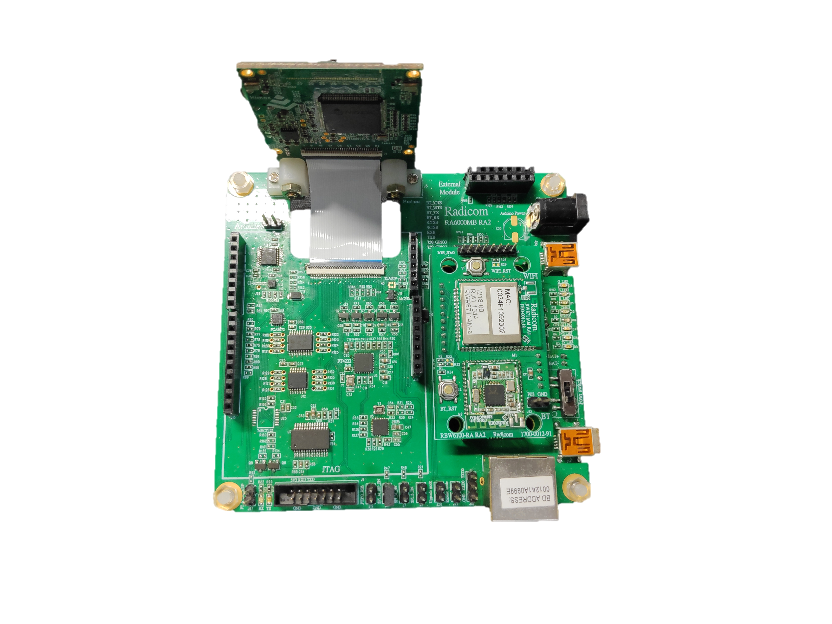
II. Implement II-1. Get Training Dataset
Step4: Short J20 and J11 for update application mode
Step5: Use[Synopsys_SDK_V21\tools\HMX_FT4222H_GUI\GUI_binary \
HMX_FT4222H_GUI.exe]tool and download image file to CPU
Step6: Open J20 for run mode
Step7: Press reset button SW4. MCU will reset and run the application
Step4:
Step6:
J11
J20

Slide 10
II. Implement II-1. Get Training Dataset
Step8: Open the terminal log to record and output RAW image data.
Step9: After key in “A”, WE I start to capture and send image data.
Fig. 7 Use the terminal to output log

Slide 11
II. Implement II-1. Get Training Dataset
Step10: Delete irrelevant content in logs
Delete
Fig. 8 Delete and only save the image part

Slide 12
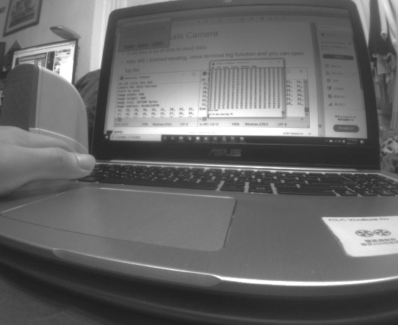
II. Implement II-1. Get Training Dataset
Step11: Copy log file to [Synopsys_SDK_V21\Example_Project\LabPY_raw2png]
Step12: Rename log file to "camera_y.log"
Step13: Open "./LabPY_raw2png/raw2png.ipynb" with Jupyter Notebook
Step14: Run and get "my_gray.png"

Slide 13
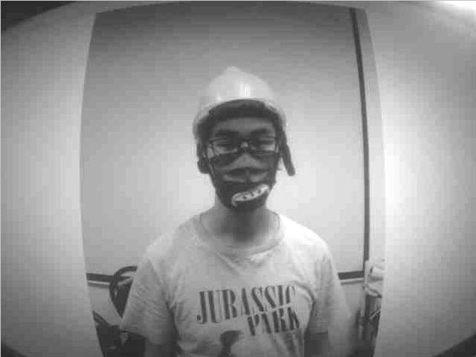
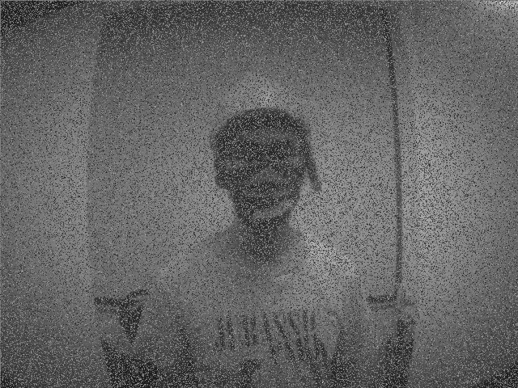
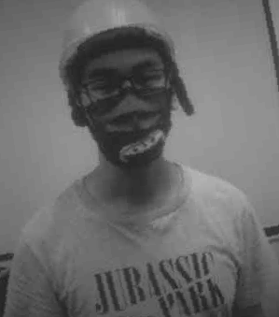
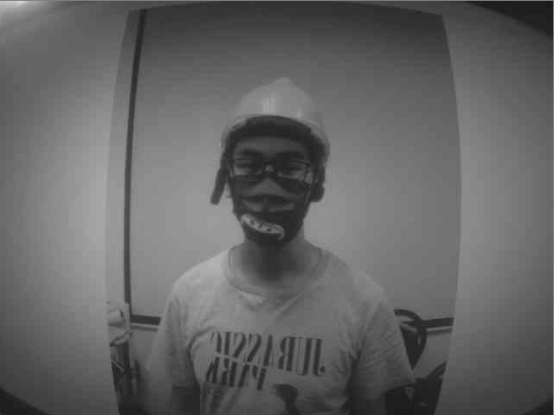
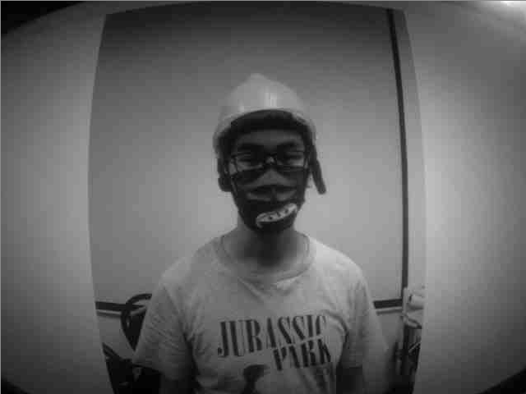
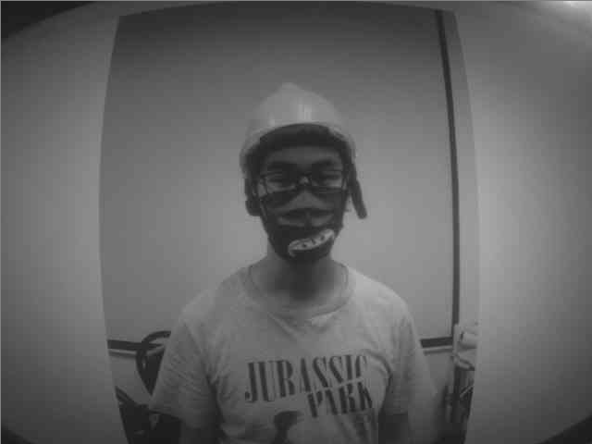
II. Implement II-2. Data Augmentation
In the real world scenario, we may have a dataset of images taken in a limited set of conditions. But our target application may exist in a variety of conditions, such as different orientation, location, scale, brightness etc. We account for these situations by training our neural network with additional synthetically modified data.
Data
Augmentation
Fig. 10 Data Augmentation

Slide 14
II. Implement II-2. Data Augmentation
>>> import augly.image as imaugs
>>> image = imaugs.blur(aug_image,output_path=path) #模糊
>>> image = imaugs.random_noise(aug_image,output_path=path) #隨機噪聲
>>> image = imaugs.hflip(aug_image,output_path=path) #水平翻轉
>>> image = imaugs.vflip(aug_image,output_path=path) #垂直翻轉
>>> image = imaugs.brightness(aug_image,factor=random.uniform(0.1, 2),output_path=path) # 亮度
>>> image = imaugs.rotate(aug_image,degrees=random.uniform(1, 10),output_path=path) #旋轉
>>> image = imaugs.sharpen(aug_image,factor=random.uniform(5, 20),output_path=path) #銳化

Slide 15
II. Implement II-2. Model Building
>>> model =Sequential()
>>> model.add(Conv2D(8,(3,3),
>>> input_shape=(img_width, img_height, 1)))
>>> model.add(Activation('tanh'))
>>> model.add(MaxPooling2D(pool_size=(2,2)))
>>> model.add(Flatten())
>>> model.add(Dense(64))
>>> model.add(Activation('tanh'))
>>> model.add(Dense(1))
>>> model.add(Activation('softmax’))
>>> print(model.summary())

Slide 16
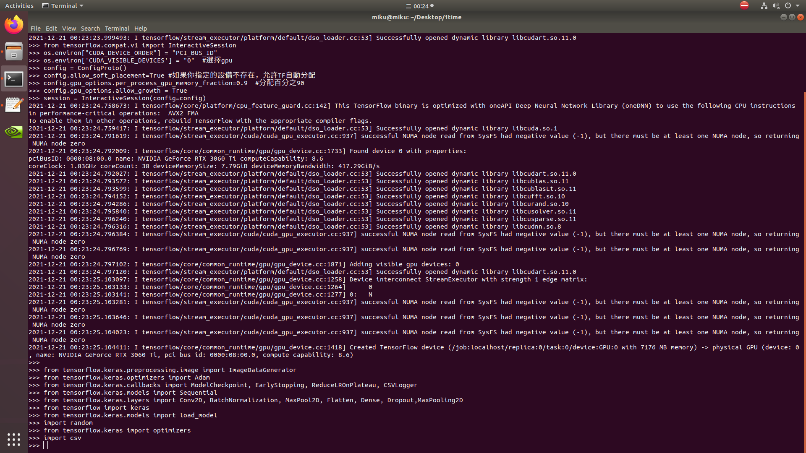
II. Implement II-2. Model Building

Slide 17
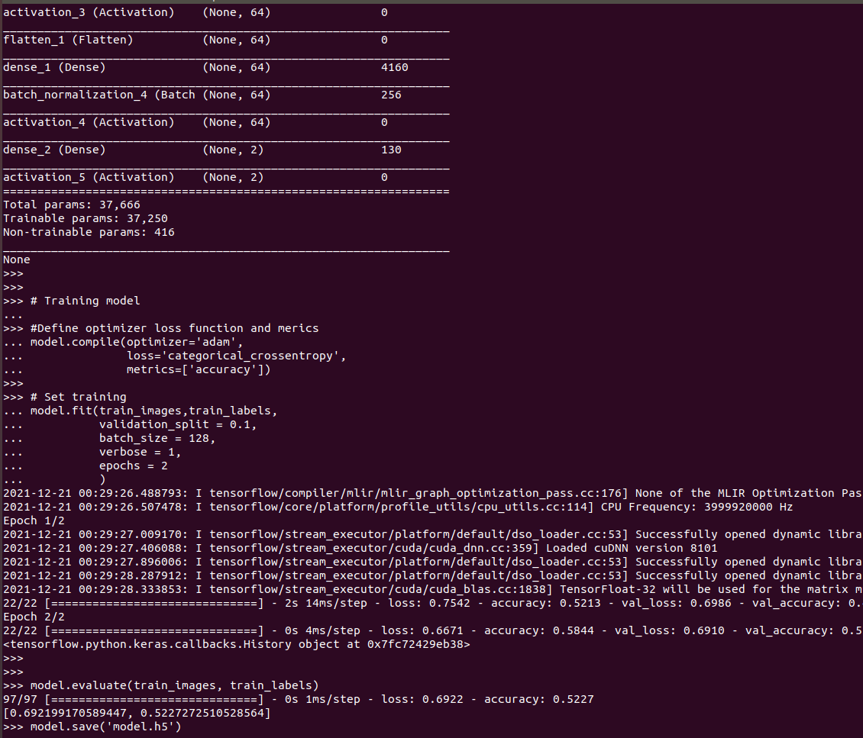
II. Implement II-2. Model Training
>>> model.compile(loss='binary_crossentropy',optimizer='rmsprop',metrics=['accuracy']) #rmsprop #Adam(1e-2)
>>> lr_reducer = ReduceLROnPlateau(monitor=‘loss’, factor=np.sqrt(0.1), verbose=1, cooldown=1,
>>> patience=3, min_lr=1e-10)
>>> earlystop = EarlyStopping(monitor='val_loss', min_delta=0,
>>> patience=7, verbose=0,
>>> mode='auto’, baseline=None,
>>> restore_best_weights=False)
>>> callbacks = [lr_reducer, earlystop]
>>> print('starting training....')
>>> history = model.fit(x_train,y_train, batch_size=batch_size,
>>> epochs=epochs, validation_split=0.1,
>>> shuffle=True, verbose=1,
>>> callbacks=callbacks)

Slide 18
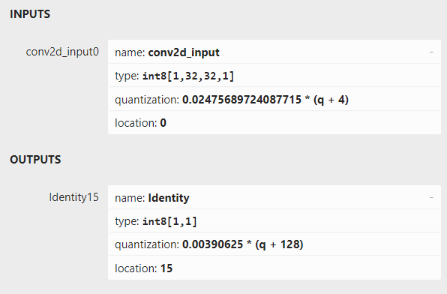
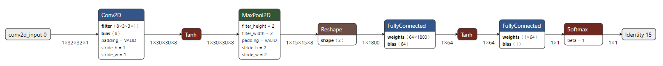
II. Implement II-2. Model Check
Can pip install netron ,and check model structure.
Fig. 13 Use netron.app can see model structure.

Slide 19
II. Implement II-2. TFLiteConvert
>>> converter = tf.lite.TFLiteConverter.from_keras_model(model)
>>> converter.optimizations = [tf.lite.Optimize.DEFAULT]
>>> converter.target_spec.supported_ops = [tf.lite.OpsSet.TFLITE_BUILTINS_INT8]
>>> converter.inference_input_type = tf.int8
>>> converter.inference_output_type = tf.int8
>>> tflite_model = converter.convert()
>>> preprocessed_test_images = tf.cast(train_images, tf.float32)
>>> emnist_ds = tf.data.Dataset.from_tensor_slices((preprocessed_test_images)).batch(1) #construct a dataset
>>> def representative_data_gen():
>>> for input_value in emnist_ds.take(100):
>>> yield [input_value]
>>> converter.representative_dataset = representative_data_gen
>>> import pathlib
>>> converted_model = converter.convert()
>>> generated_dir = pathlib.Path("generated/")
>>> generated_dir.mkdir(exist_ok=True, parents=True)
>>> converted_model_file = generated_dir/"model.tflite"
>>> converted_model_file.write_bytes(converted_model)

Slide 20
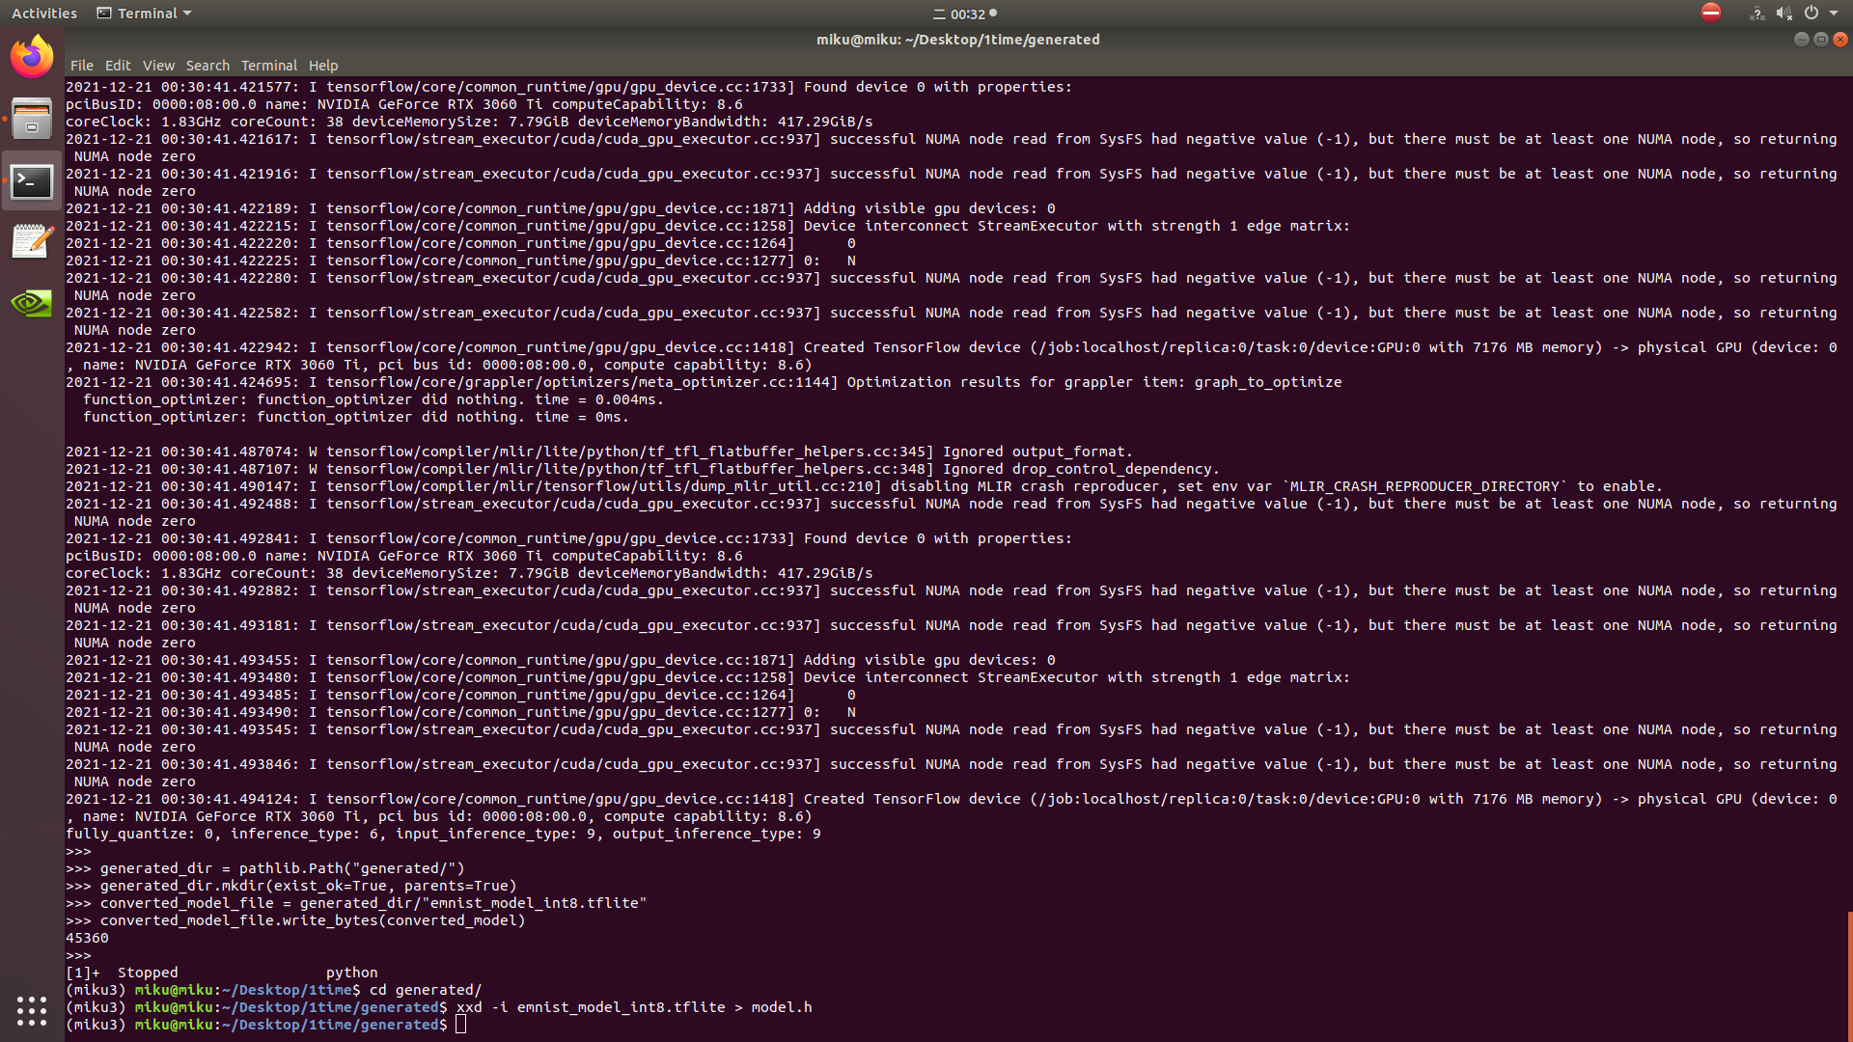
II. Implement II-2. TFLiteConvert

Slide 21
II. Implement II-2. Create .img
Step1: In order to integrate converted model into TFLM application we
have to save it as a C array.
$ xxd -i model.tflite > model.h
Step2: Copy " model.h " to " Example_Project\Lab5_tflm_emnist_letter "
Step3: Set model setting in " model settings.cpp " and " model settings.h "
Step4: Edit micro_op_resolver for your model in " tflitemicro_algo cpp "
Step5: Edit TensorFlow input and output buffer in " tflitemicro_algo cpp “
Step6: make files
$ make clean
$ make
$ make flash

Slide 22
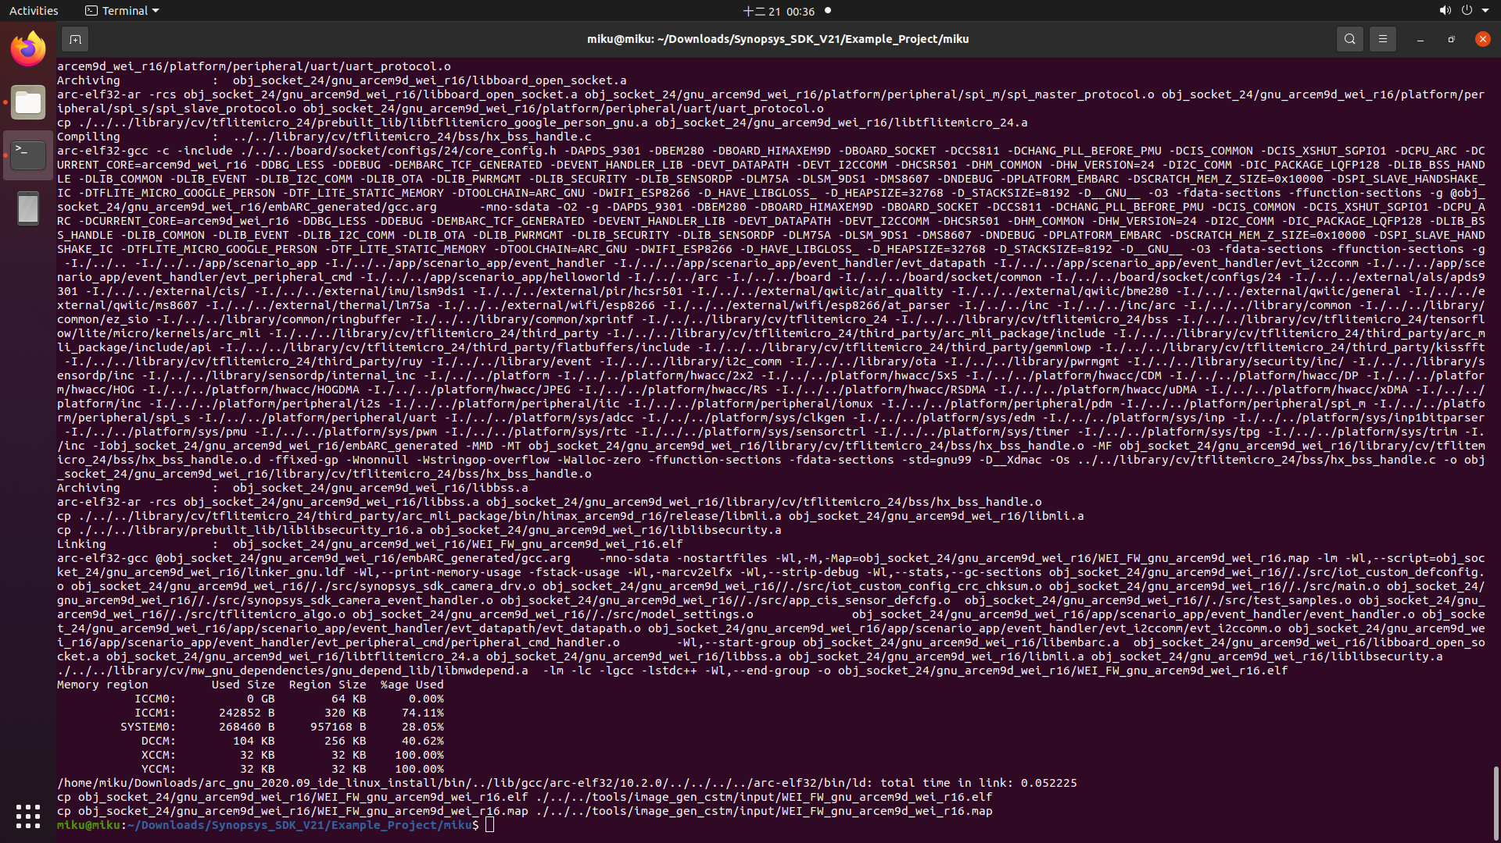
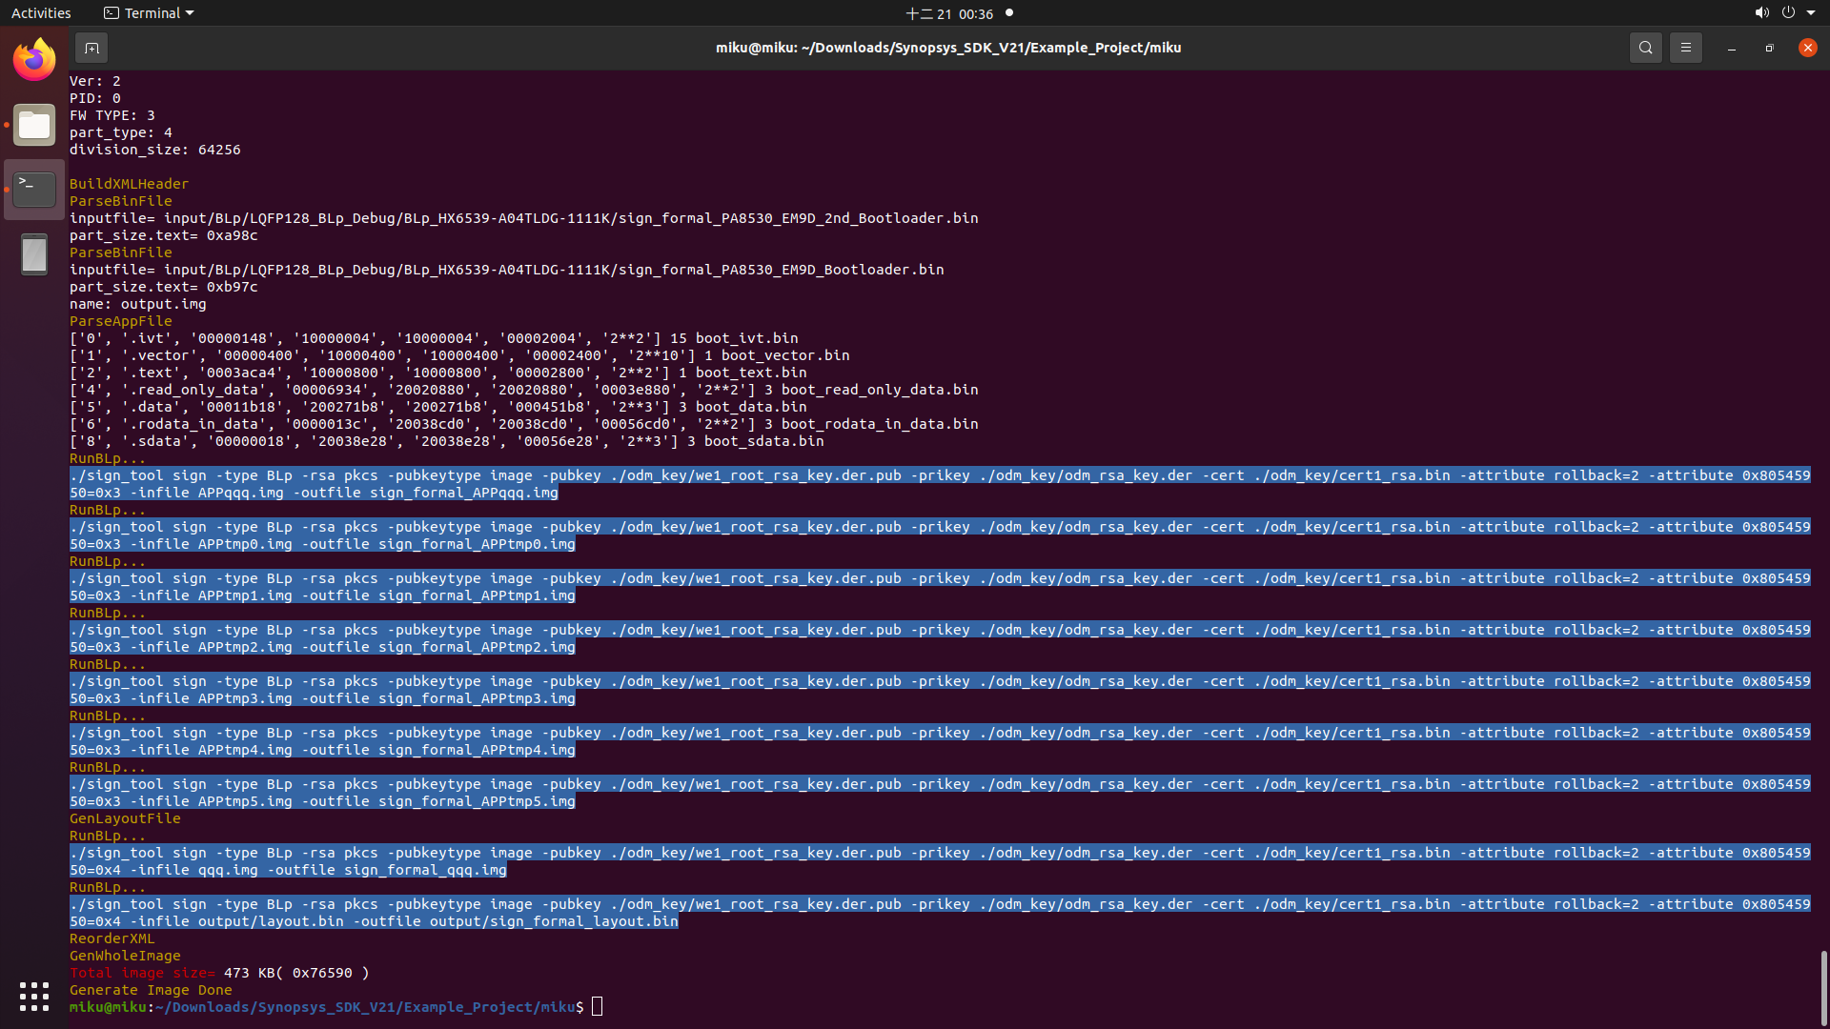
III. Implement III-2. Create .img
Fig. 15 Make and create .img flile.

Slide 23
II. Implement II-3. Upload CPU
Step1: Open the [HMX_FT4222H_GUI.exe].
Step2: Push the [Read ID]button,and to check it shows [ef/60/15].
Step3: Push the [Chip Erase]button.
Step4: Choose the file location and press the [Programing] button.
Step5: Power off ,and open J20 for run mode

Slide 24
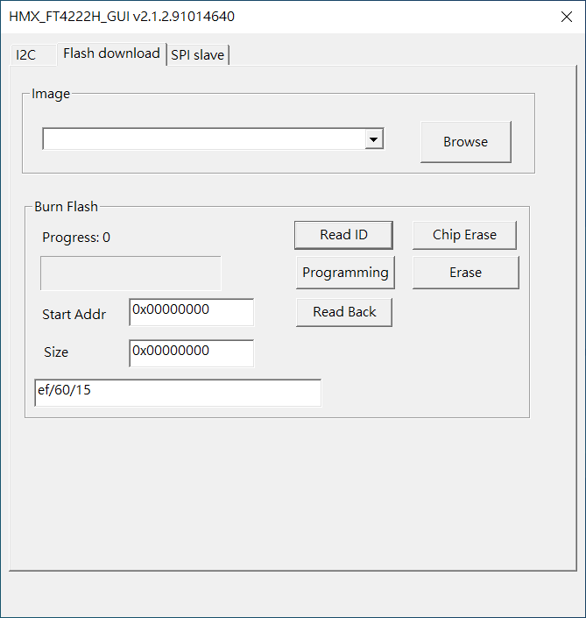
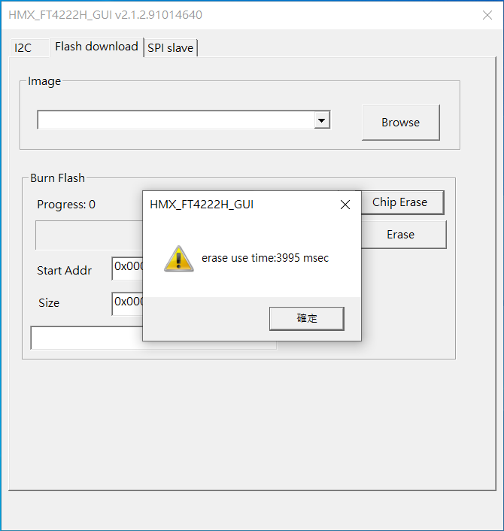
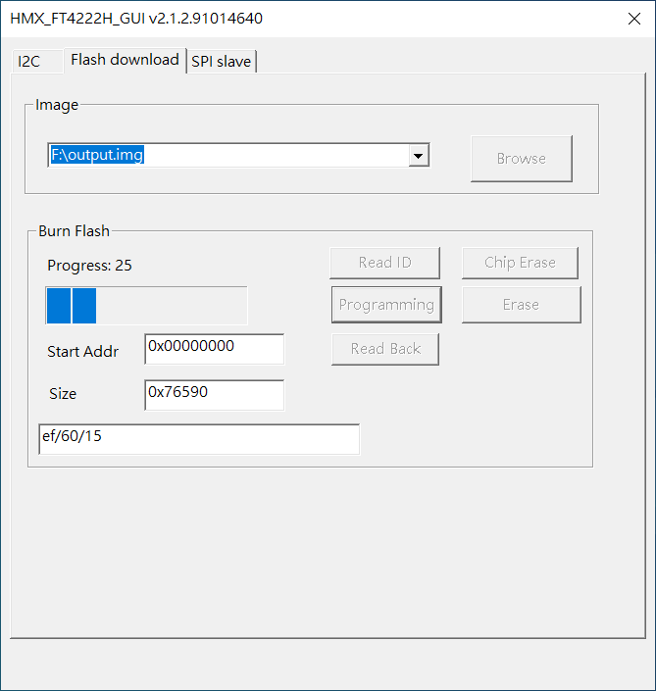
II. Implement II-3. Upload CPU
Step1.
Step2.
Fig. 16 Update .img file

Slide 25
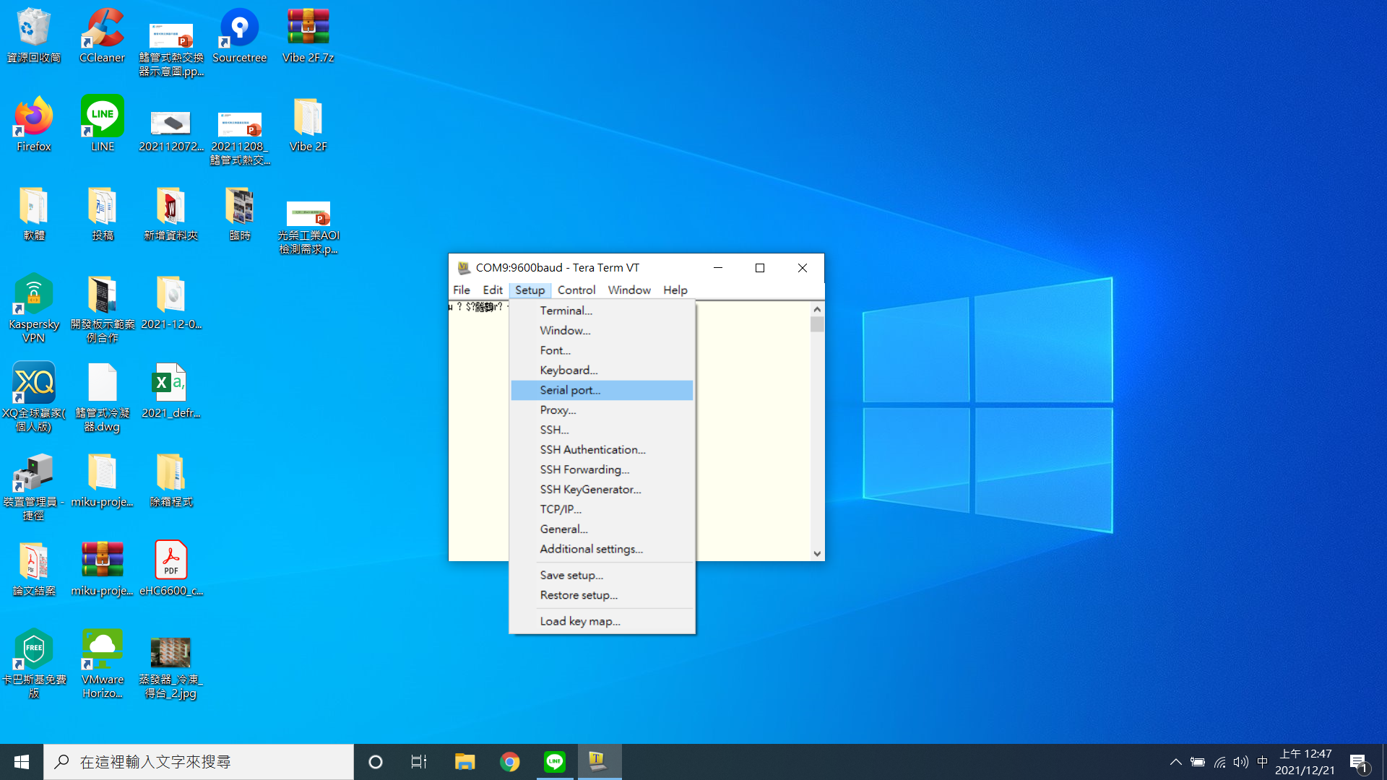
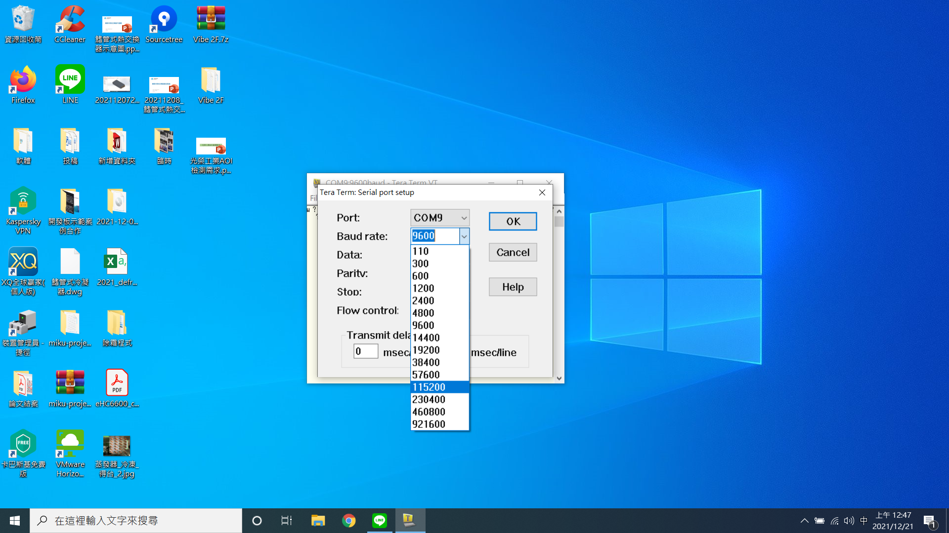
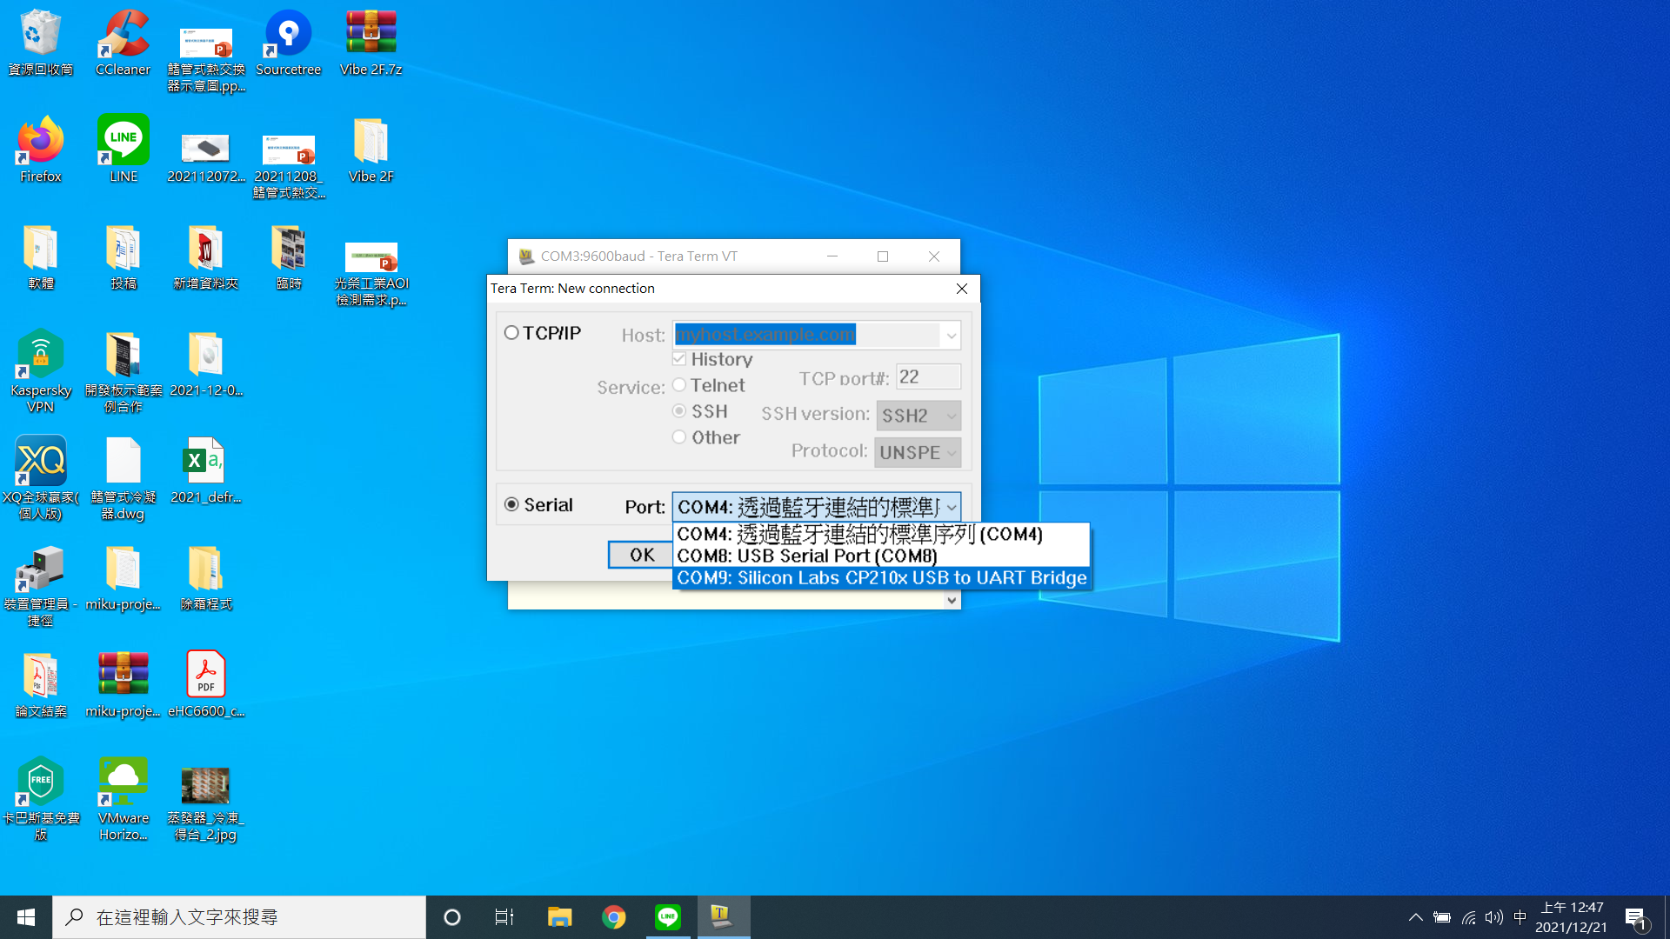
II. Implement II-4. Runtime
Step2.
Step3.
Step1.
Fig. 17 Operate Tera Term

Slide 26
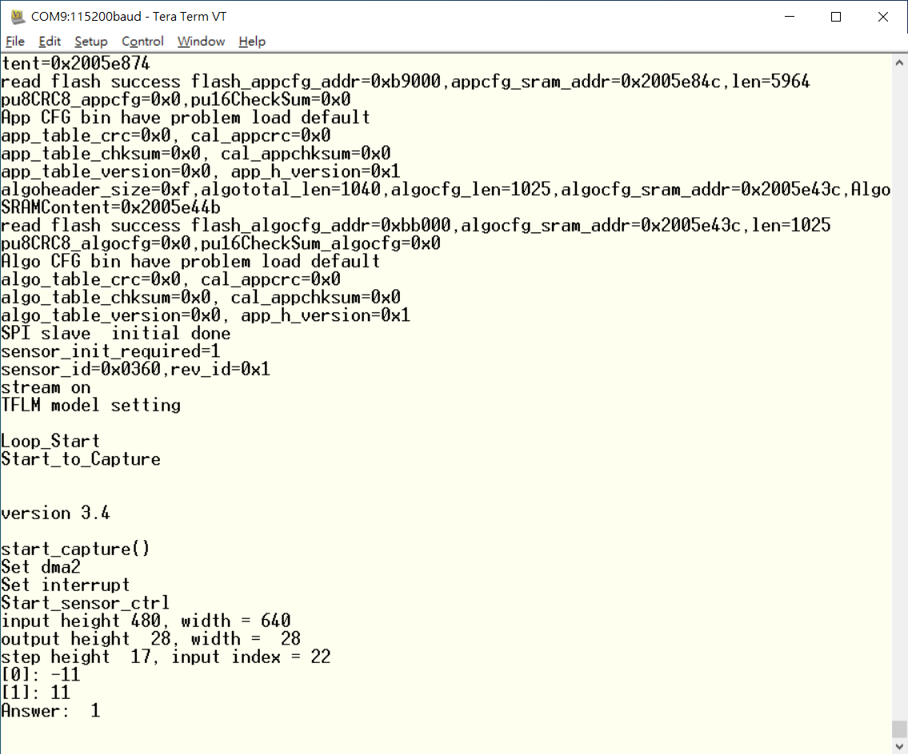
II. Implement II-4. Runtime
Fig. 18 Output print

Slide 27
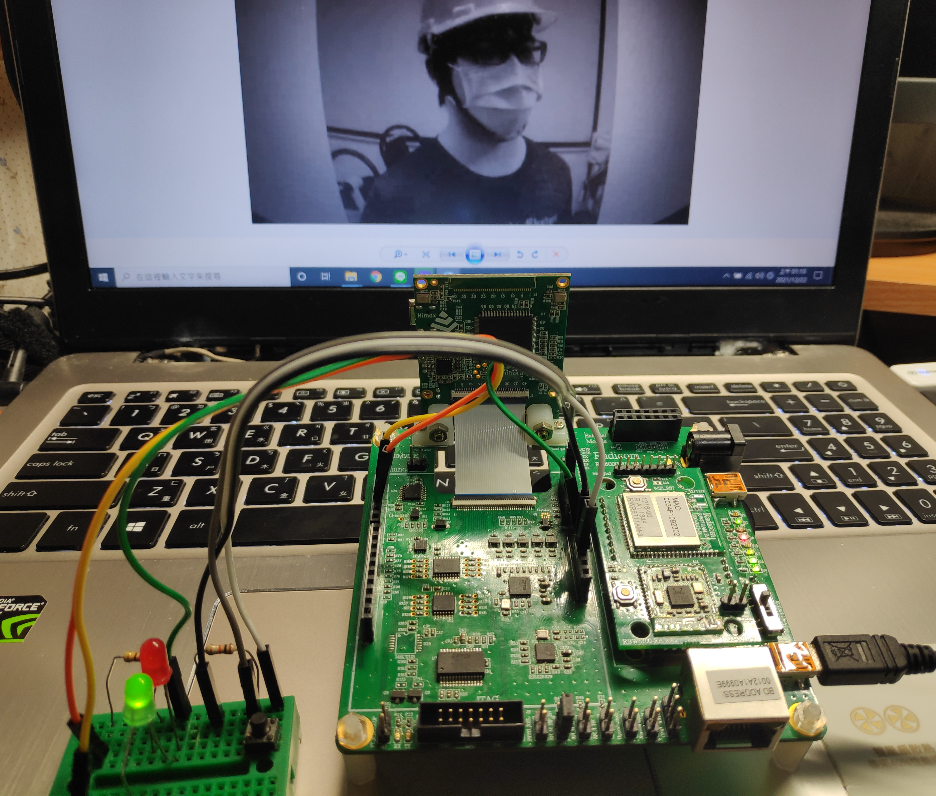
II. Implement II-4. Runtime
When it is detected that you are wearing Hard Hats , the green signal light will be displayed, otherwise it will be red. The button is a digital input and can also be replaced by a photoelectric switch.

Slide 28
III. Suggestion
The human detection program can be added to determine whether the target enters the detection area, and with the hard hats detection of this project, can don’t need to install a photoelectric switch.
Can be combined with linebot or web page for remote alarm notification.

